Slide 1
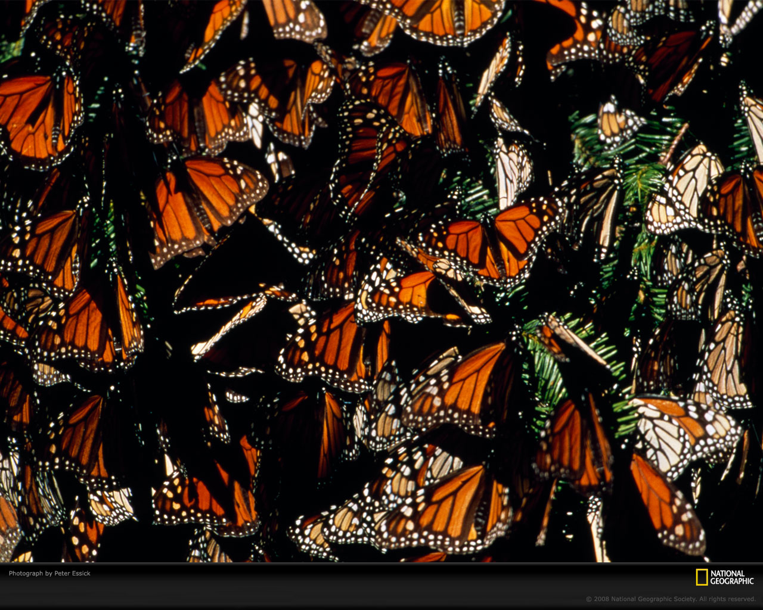
organism
population
community
ecosystem
biosphere
Population Ecology
(Ch.5)

Slide 2
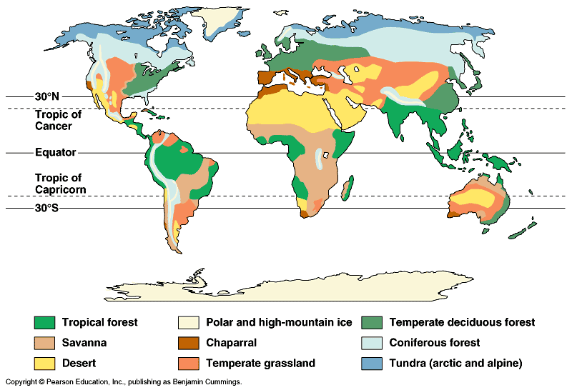
Factors that affect Population Size
Density Independant - Abiotic factors
Amount of sunlight & temperature
precipitation / water
soil / nutrients
Density Dependant -Biotic factors
other living organisms
prey (food)
competitors
predators, parasites, disease

Slide 3
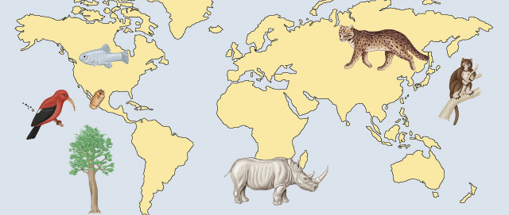
At risk populations
Endangered species
limitations to range / habitat, over hunting, fishing
Loss of habitat (clear cutting, development, farming)
Changes in environment, competition. Introduced species that take over!
Devil’s hole
pupfish
Iiwi
Hawaiian
bird
Socorro
isopod
Iriomote cat
New Guinea
tree
kangaroo
Catalina
Island
mahogany
tree
Northern white rhinoceros

Slide 4
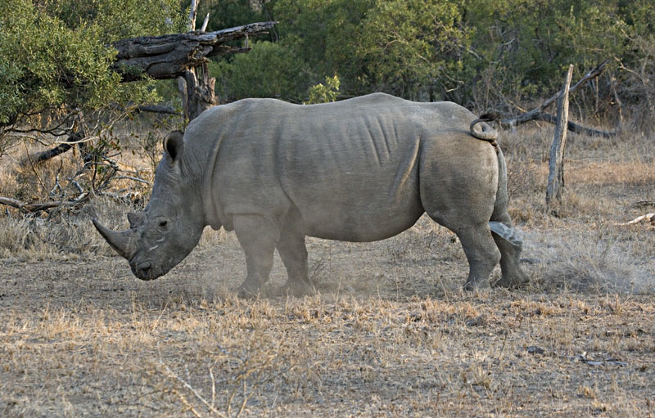
marking territory = competition

Slide 5
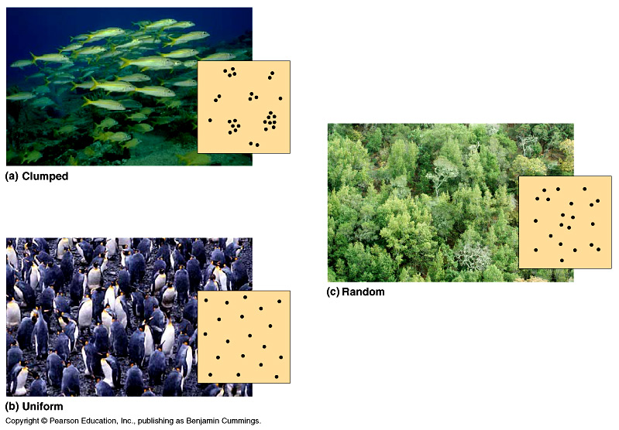
Population Spacing
Dispersal patterns of a population
Provides insight into the environmental associations & social interactions of individuals in population
clumped
random
uniform
Notes:
Within a population’s geographic range, local densities may vary substantially. Variations in local density are among the most important characteristics that a population ecologist might study, since they provide insight into the environmental associations and social interactions of individuals in the population. Environmental differences—even at a local level—contribute to variation in population density; some habitat patches are simply more suitable for a species than are others. Social interactions between members of the population, which may maintain patterns of spacing between individuals, can also contribute to variation in population density.

Slide 6
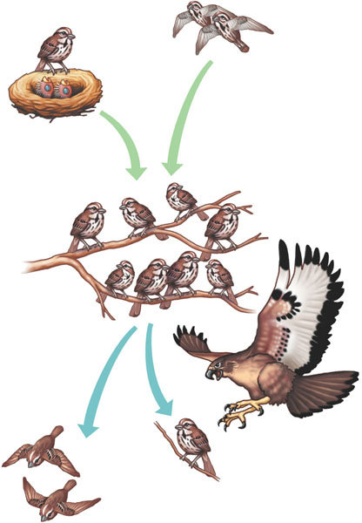
Population Size
Births and immigration add individuals to a population.
Changes to population size
(4 factors)-
adding & removing individuals from a population
1)Birth (B)
2)Death (D)
3)Immigration (I)
4)Emigration (E)
Births
Immigration
PopuIation size
Emigration
Deaths
Deaths and emigration remove individuals from a population.

Slide 7
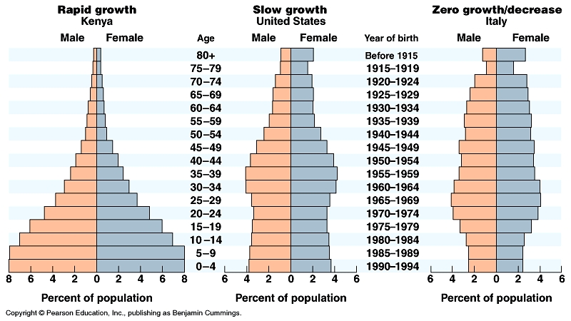
Age structure
Relative number of individuals of each age
What do these data imply about population growth in these countries?

Slide 8
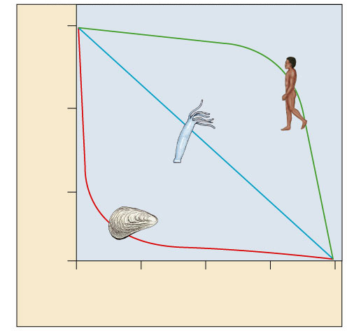
Survivorship curves
What do these graphs tell about survival & strategy of a species?
Generalized strategies
1000
Human
(type I)
I. High death rate in post-reproductive years
Hydra
(type II)
100
II. Constant mortality rate throughout life span
Survival per thousand
Oyster
(type III)
10
III. Very high early mortality but the few survivors then live long (stay reproductive)
1
0
25
50
75
100
Percent of maximum life span
Notes:
A Type I curve is flat at the start, reflecting low death rates during early and middle life, then drops steeply as death rates increase among older age groups. Humans and many other large mammals that produce few offspring but provide them with good care often exhibit this kind of curve. In contrast, a Type III curve drops sharply at the start, reflecting very high death rates for the young, but then flattens out as death rates decline for those few individuals that have survived to a certain critical age. This type of curve is usually associated with organisms that produce very large numbers of offspring but provide little or no care, such as long–lived plants, many fishes, and marine invertebrates. An oyster, for example, may release millions of eggs, but most offspring die as larvae from predation or other causes. Those few that survive long enough to attach to a suitable substrate and begin growing a hard shell will probably survive for a relatively long time. Type II curves are intermediate, with a constant death rate over the organism’s life span. This kind of survivorship occurs in Belding’s ground squirrels and some other rodents, various invertebrates, some lizards, and some annual plants.

Slide 9
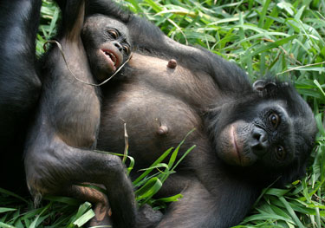
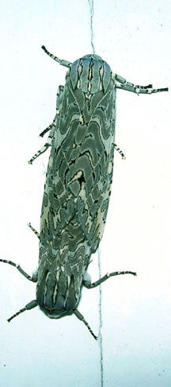
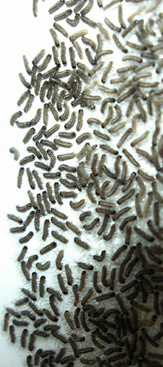
Reproductive strategies
K-selected
late reproduction
few offspring
invest a lot in raising offspring
Primates (us)
Big mammals
r-selected
early reproduction
many offspring
little parental care
insects
many plants
K-selected
r-selected

Slide 10
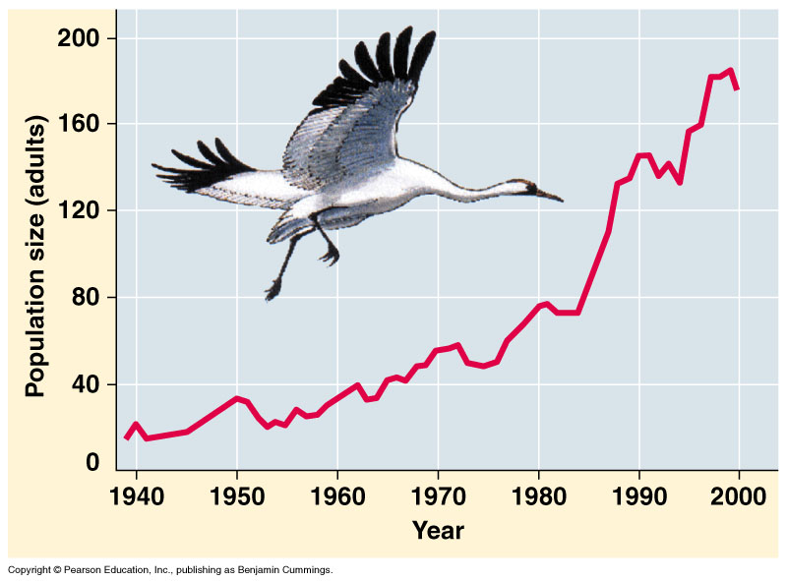
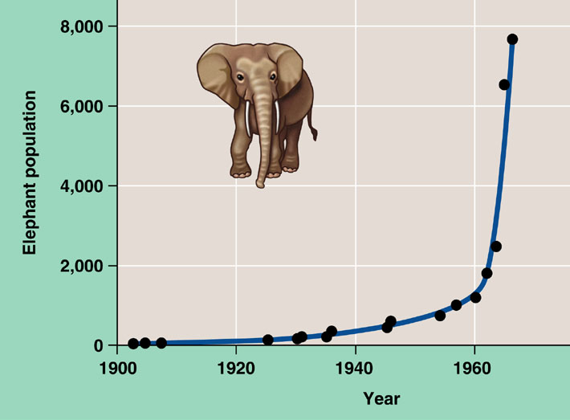
Exponential growth rate (J) curve -
Characteristic of populations without limiting factors (wide open resources)
introduced to a new environment or rebounding from a catastrophe and they grow exponentially so graph looks like the letter J.
Whooping crane
coming back from near extinction
African elephant
protected from hunting
Notes:
The J–shaped curve of exponential growth is characteristic of some populations that are introduced into a new or unfilled environment or whose numbers have been drastically reduced by a catastrophic event and are rebounding. The graph illustrates the exponential population growth that occurred in the population of elephants in Kruger National Park, South Africa, after they were protected from hunting. After approximately 60 years of exponential growth, the large number of elephants had caused enough damage to the park vegetation that a collapse in the elephant food supply was likely, leading to an end to population growth through starvation. To protect other species and the park ecosystem before that happened, park managers began limiting the elephant population by using birth control and exporting elephants to other countries.

Slide 11
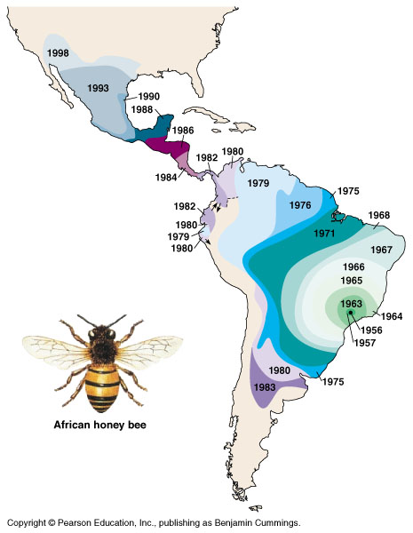
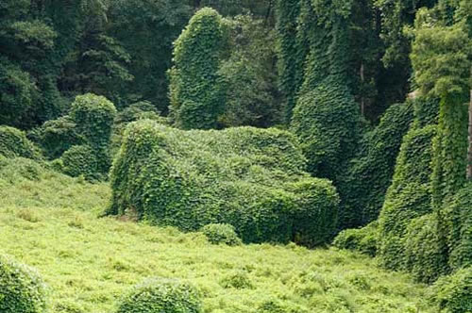
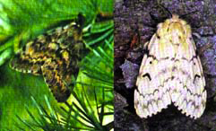
Introduced (Invasive) species – often J curve
Non-native species
transplanted populations may grow exponentially in new area
May out-compete native species
lack of predators, parasites, competitors
reduce diversity
examples
African honeybee
gypsy moth
zebra mussel
purple loosestrife
gypsy moth
kudzu

Slide 12
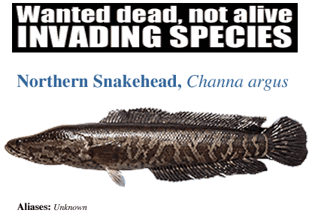
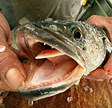
The Snakehead – A serious problem in the U.S.
Great Snakehead Problems Snakeheads eat game fish and have no predators so they can overcrowd a body of water and harm native species. They are adapted to survive in water with little oxygen and can even crawl across land for short distances on their fins, taking in oxygen from a special bronchial adaptation. They will not attack people but may injure anyone stepping on them.
http://www.youtube.com/watch?v=nmU7etSYYqI

Slide 13
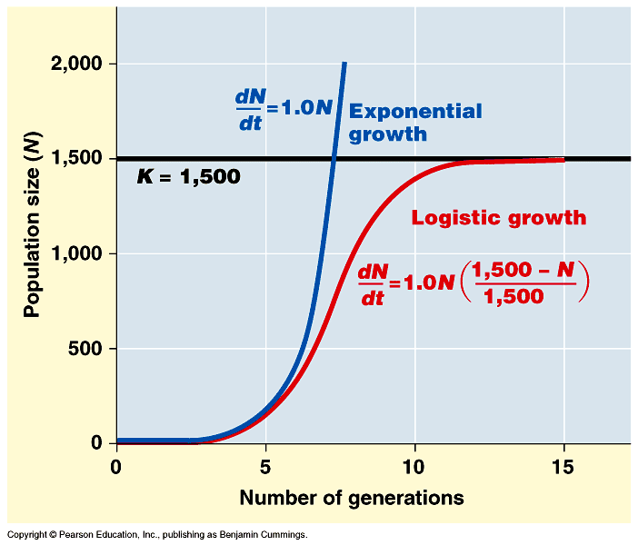
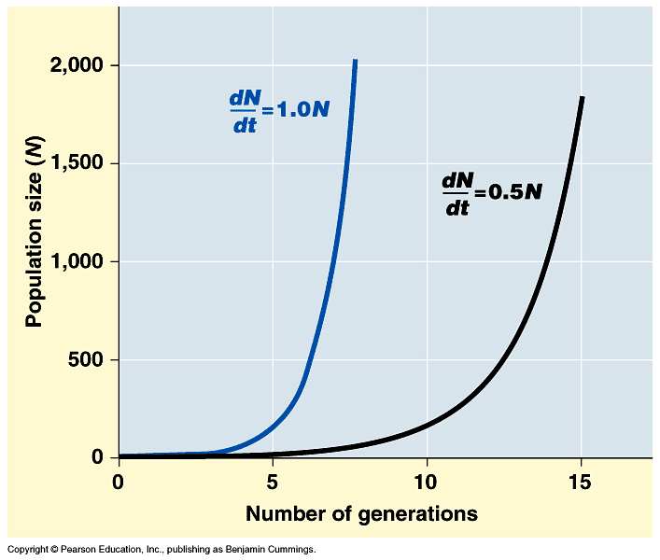
Logistic rate of growth – called an S curve
Can populations continue to grow exponentially? NO – it will reach carrying capacity and level off. The line will typically stay around K but will fluctuate some.
K = carrying capacity
Notes:
Decrease rate of growth as N reaches K

Slide 14
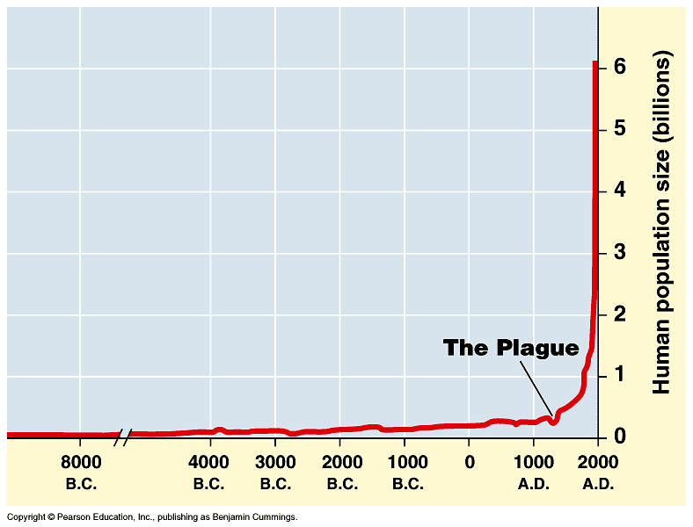
Human population growth
adding 82 million/year
~ 200,000 per day!
2005→6 billion
Significant advances
in medicine through
science and technology
What factors have contributed to this exponential growth pattern?
Industrial Revolution
Is the human population reaching carrying capacity?
Bubonic plague "Black Death"
1650→500 million
Notes:
The population doubled to 1 billion within the next two centuries, doubled again to 2 billion between 1850 and 1930, and doubled still again by 1975 to more than 4 billion. The global population now numbers over 6 billion people and is increasing by about 73 million each year. The population grows by approximately 201,000 people each day, the equivalent of adding a city the size of Amarillo, Texas, or Madison, Wisconsin. Every week the population increases by the size of San Antonio, Milwaukee, or Indianapolis. It takes only four years for world population growth to add the equivalent of another United States. Population ecologists predict a population of 7.3–8.4 billion people on Earth by the year 2025.

