Slide 1
Genetic Drift
Random changes in allele frequencies that occur in a population.
Occurs in small populations with more frequency than in large populations

Slide 2
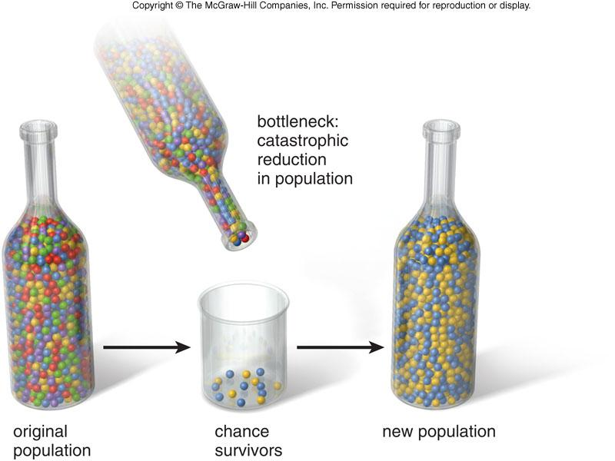
Bottleneck Effect
Change in allele frequency due to a dramatic reduction in population size
Founder Effect
Allele frequencies change when a small group becomes isolated from the larger population.

Slide 3
Speciation - Formation of a new species
Reproductive isolation
Population no longer shares genetic information and can eventually lead to speciation.
Caused by,
Behavioral Isolation
Geographic Isolation
Temporal Isolation

Slide 4
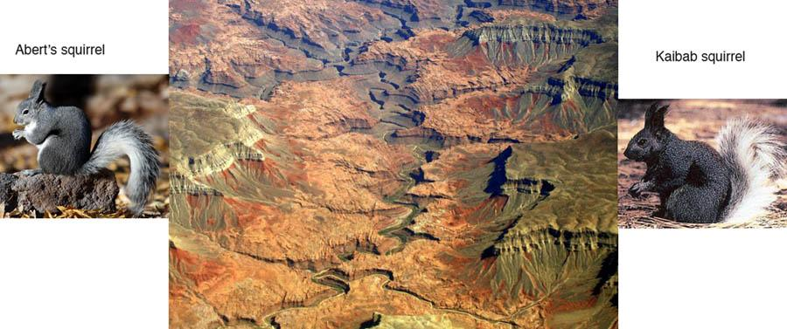
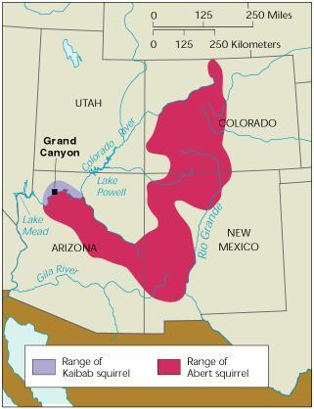
Kaibab Squirrels
North ---->

