Slide 1
Chapter 2 – The Chemistry of Life
08/23/12
Pennington

Slide 2
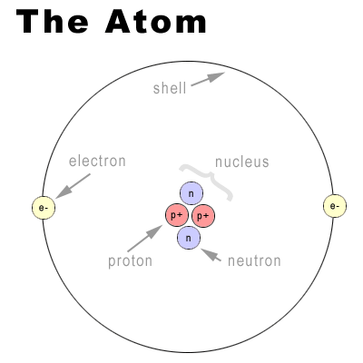
The Nature of Matter
Atoms – building blocks. Important ones for the human body (and all life forms)
C H N O P S
The ELEMENTS on the periodic table are pure substances – made of only 1 type of atom (can’t be broken down).

Slide 3
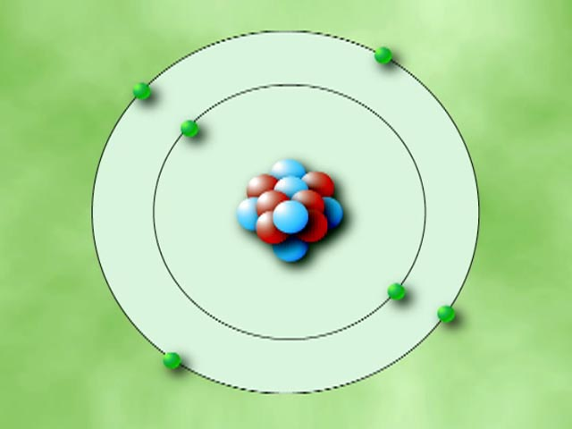
Parts of the atom – 3 subatomic particles
Protons - + charge, found in nucleus
Neutron – no charge, found in nucleus
Electron: - charge, found in levels around the nucleus.
2 go in the 1st level
Up to 8 fit in the 2nd level etc…
The outer e- are called valence and they are the reason that atoms bond with other atoms. The outermost shell always is most stable if it is filled!!

Slide 4
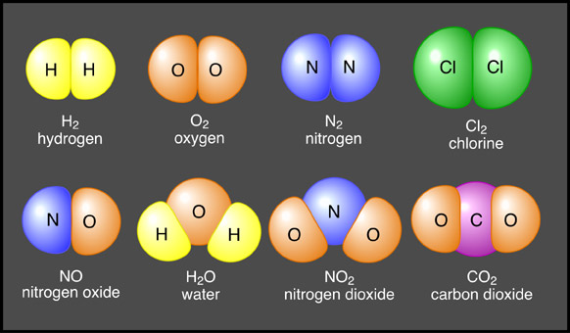
Chemical Compounds -
Combining one or more elements together in a specific ratio.
Ex: CO2 , H2O, salt = NaCl

Slide 5
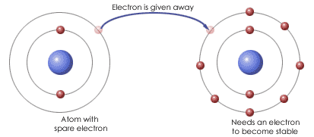
2 Types of Chemical Bonds:
1. Ionic = electrons are transferred from one atom to another (to equal 8), so they are both more stable.

Slide 6
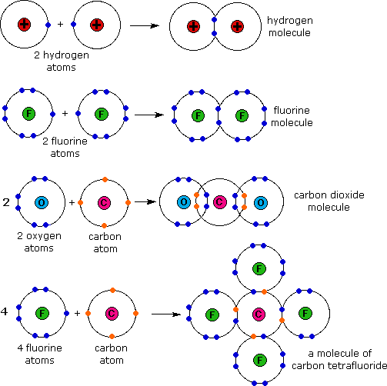
2. Covalent Bonds -
Forms when 2
electrons are shared
by atoms instead of
being transferred: Look
At the prefix “co”!
These bond are most
common in biology.

Slide 7
Practice:
How many electrons in a Lithium atom? So how many protons? Neutrons?
How many electrons in Carbon? So how many protons? Neutrons?
How many electrons in Oxygen? Protons, neutrons?

Slide 8
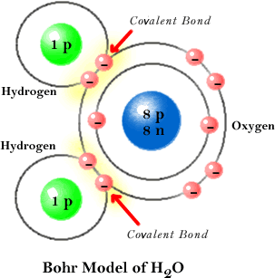
Water
Water is composed of an oxygen (O) atom and two hydrogen (H) atoms.
The O and H atoms share electrons. These shared electrons make up the covalent bonds between the O and the H.

Slide 9
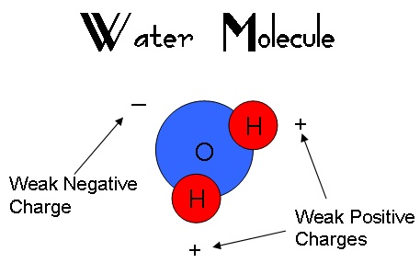
Water is polar
O has a stronger affinity for electrons than H, so the electrons in a water molecule tend to concentrate around the O.
Water is a polar molecule, meaning that it has an uneven distribution of charge throughout the molecule.

Slide 10
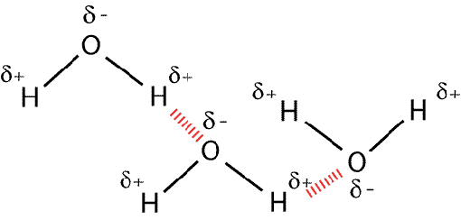
Hydrogen bonding in Water
In water, a hydrogen bond (dashed red line) forms between the partial positive and negative charges in different water molecules.

Slide 11
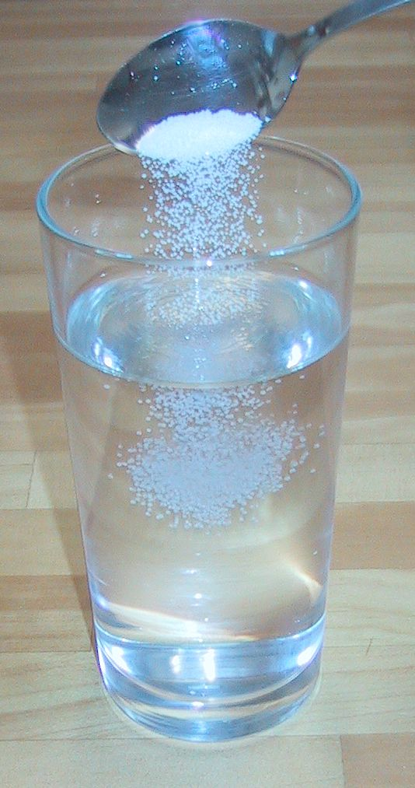
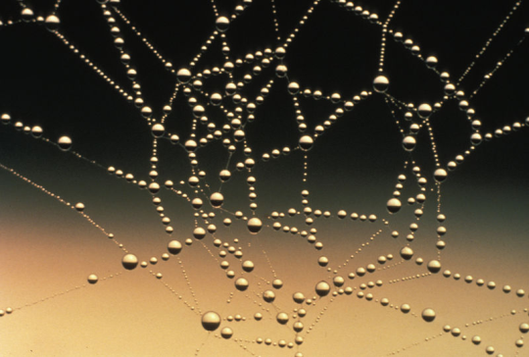
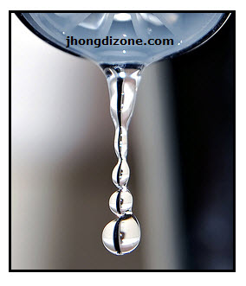
Water is a good solvent
.
Most biochemical reactions occur when the chemicals involved are dissolved in water. The internal environment of the cell is composed mostly of water.
Water’s polarity and ability to hydrogen bond makes it a particularly good solvent.
Cohesion – water likes other water
Adhesion – water likes other materials too.

