Slide 1
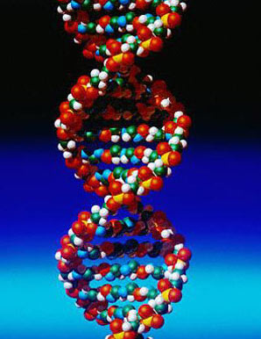
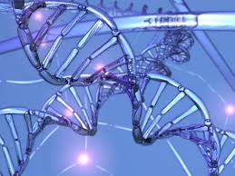
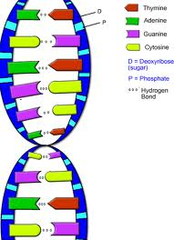
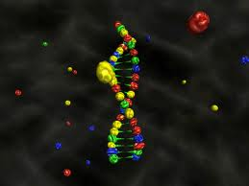
Chapter 12 From DNA to Protein
How you were formed!!

Slide 2
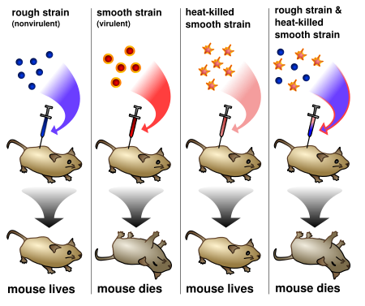
DNA
Stands for “Deoxyribo Nucleic Acid”
How do we know it is the genetic carrier? From several experiments that proved it!
Griffith’s mice – Transformation!! Bacteria can pick up and use other DNA.

Slide 3
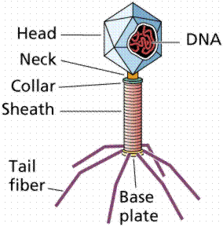
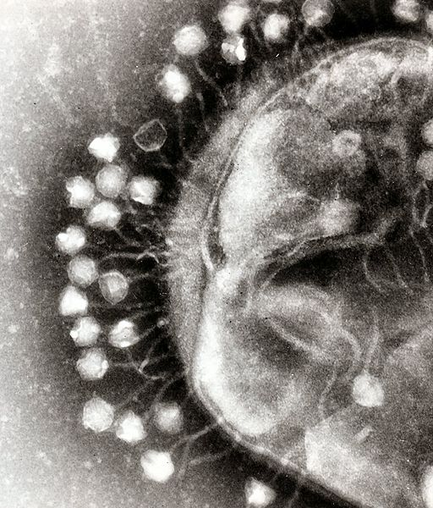
Also, the Hershey-Chase Exp:
Bacteriophage – virus that infects bacteria
Inserted radioactive DNA into virus and watched it go into bacteria..so they knew that
DNA was the culprit and not any other part!

Slide 4
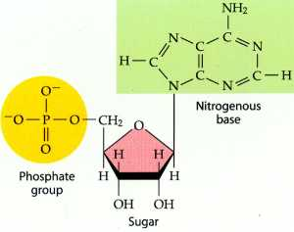
The parts of DNA:
3 things to remember!!
DNA is made of the monomer nucleotides
There is a 1) phosphate head
2) Deoxyribose sugar
3) Nitrogenous base – there
are 4 kinds of bases in DNA:
A – adenine
T – thymine
C – cytosine
G - guanine

Slide 5
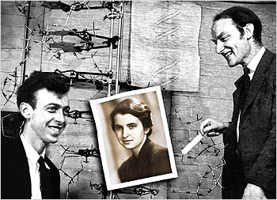
The Shape: Double Helix
One of the biggest mysteries of our time.
In 1953 – James Watson (American) and Francis Crick (English) solve the puzzle.
They “borrowed” an x-ray from Rosalind Franklin.
They won the Nobel Prize,
she died from cancer.

Slide 6
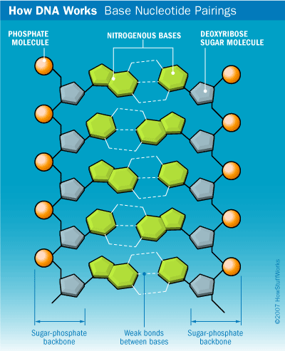
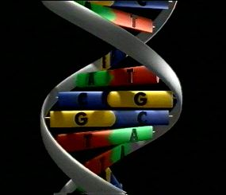
Now we know exactly how DNA works:
It looks like a twisted ladder.
Every A = T
Every C = G
Each strand is the
opposite of the other.

Slide 7
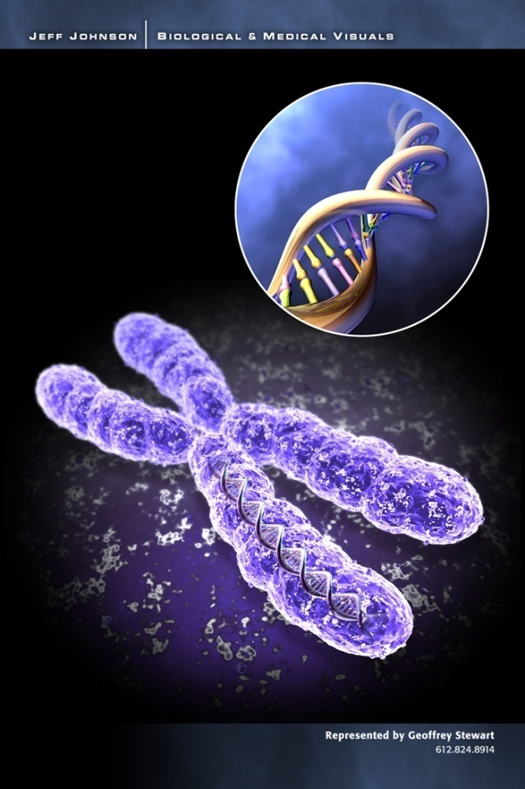
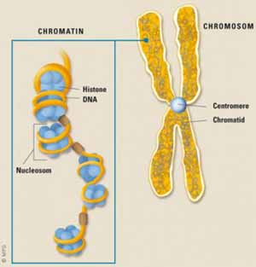
DNA and Chromosomes!
DNA is very long (you’ll see it) and has to pack tightly to fit inside the nucleus of a cell.
It wraps around proteins called HISTONES, and condenses during mitosis. http://www.youtube.com/watch?NR=1&feature=endscreen&v=gbSIBhFwQ4s

Slide 8
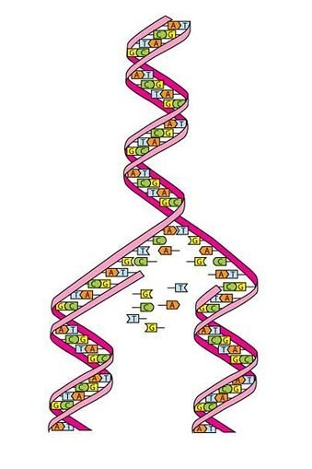
Making a Copy of Itself….
The DNA “unzips” into 2 stands
The enzyme Polymerase
attaches to a strand and makes
the opposite template.
Use base pairing rules to make
the template to: ACCGTAAGCC
http://www.youtube.com/watch?v=z685FFqmrpo&feature=related

Slide 9
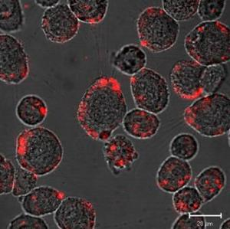
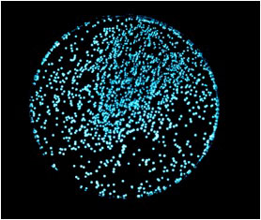
Does every cell have the same DNA?
Why don’t all cells make “eyes”? Different genes are turned on or off in different cells!
Can we “insert” new genes ?? Yes… We can create GMO’s (genetically modified organisms)
Watch! In AP we put jellyfish genes into bacteria to make them glow.
http://www.youtube.com/watch?v=fVx9m3ucGcY

