Slide 1
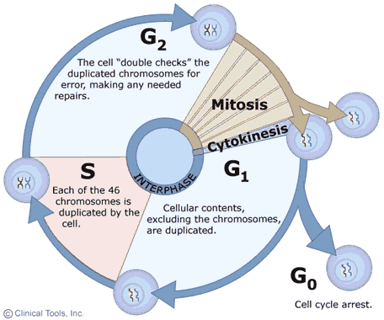
Chapter 10 – CELL GROWTH AND DIVISION
Pennington 12/6/11

Slide 2
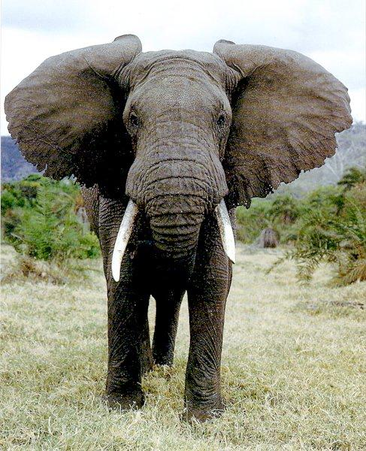
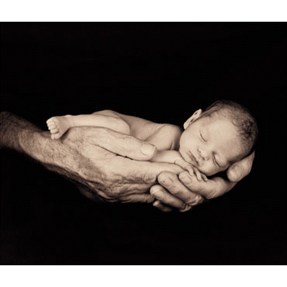
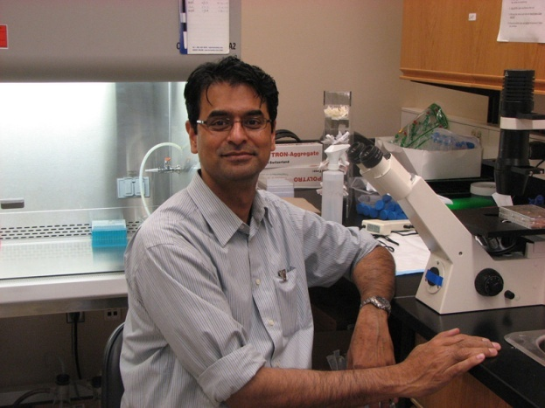
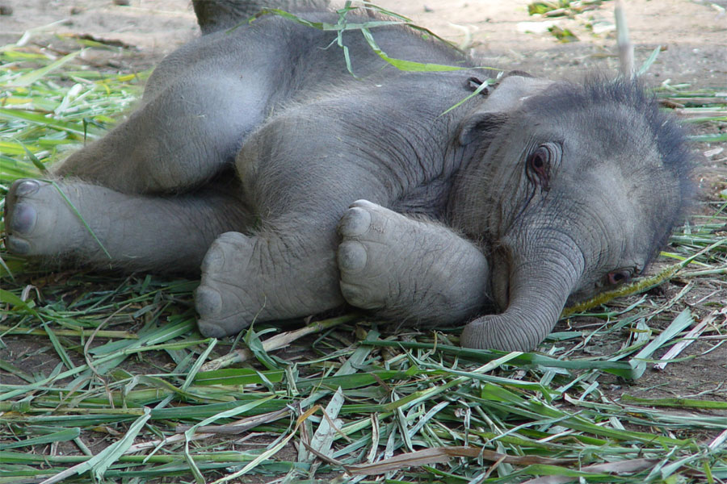
As you grow bigger….
Are your cells expanding to huge sizes or do you just have more of them?

Slide 3
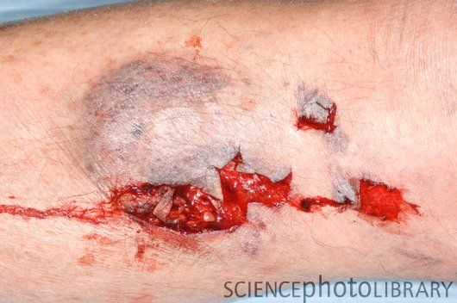
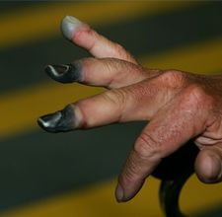
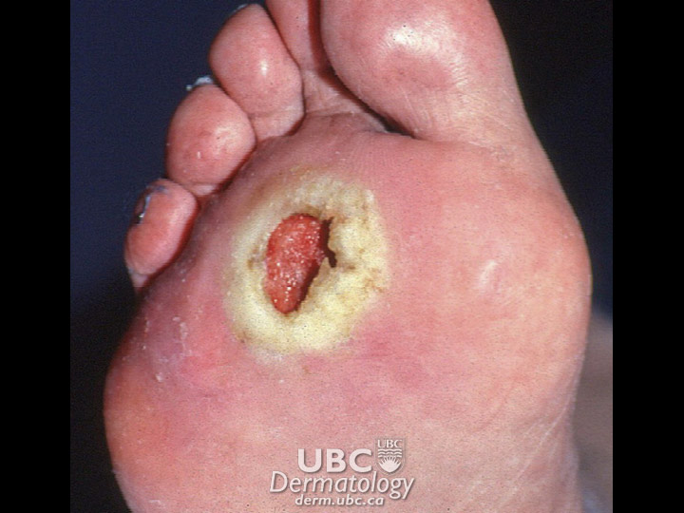
When your cells die, how do they get replaced? Is it important that they are identical to the cells that were damaged?

Slide 4
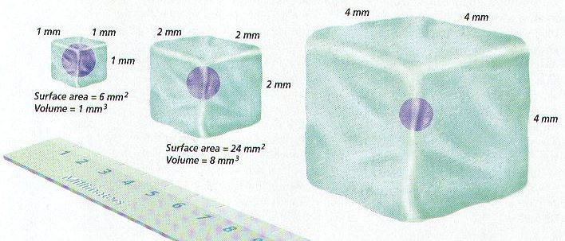
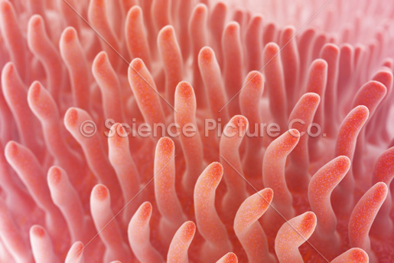
Cell size…
As a cell grows larger too many demands are placed on the nucleus.
The cell has trouble moving nutrients and wastes across the membrane, so it can’t get very big. The Surface Area/Volume ratio is important – the bigger the ratio better! So smaller cells, have higher ratios. A 6:1 ratio is better than a 3:1 Which shape is best? Cube, sphere or cylinder?

Slide 5
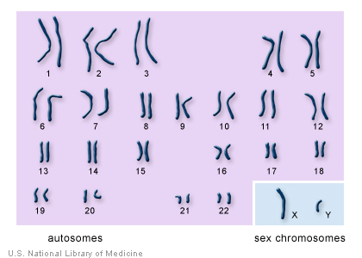
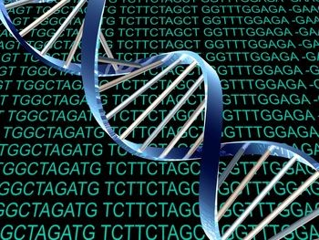
Cell Division…Body cells only,
Before a cell becomes too big – it divides into two “daughter” cells.
Before division, the cell makes a copy of all its DNA so that each daughter cell gets one.
Different organisms have different numbers of chromosomes. We have 23 pairs, fruit flies = 8, carrots = 18.

Slide 6
Asexual Reproduction
Some creatures don’t need a mate and can reproduce an offspring by dividing its own cells.
Bacteria
Protists
Fungi (yeast)
Animals (hydra)
Plants (aspen)
Today you will look at a few slides of this process.

Slide 7
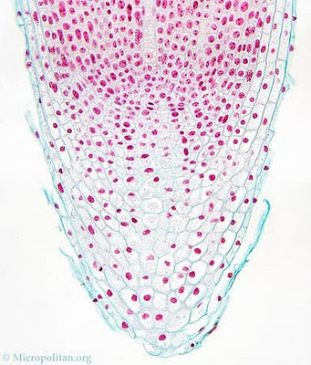
These are cells from onion roots:

Slide 8
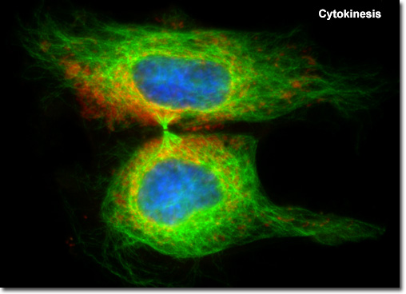
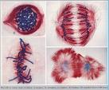
2 stages of The Cell Cycle:
1) Interphase – ¾ of the cycle – consists of G1(growth), S (synthesis of DNA) and G2(organelle production).
2) Mitosis – division of the nucleus, making sure each cell has 1 full copy of
the DNA.

Slide 9
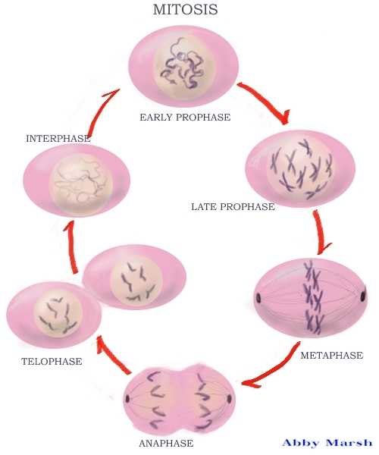
Mitosis is in 4 stages: PMAT
1) Prophase
2) Metaphase
3) Anaphase
4) Telophase

Slide 10
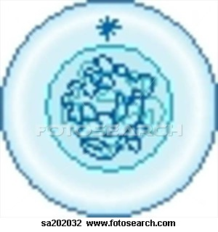
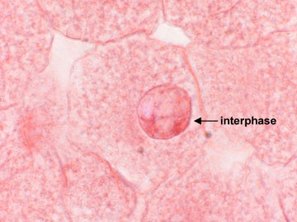
Interphase: Biggest part of a cells life – most cells are in this stage.
Cell grows - DNA replicates (in S) and centrioles appear (in animal cells). The cell is getting ready to divide and go through PMAT.

Slide 11
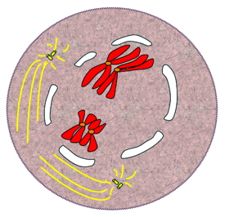
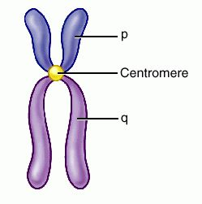
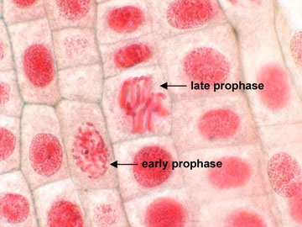
Prophase:
Chromosomes condense (form X shape) and spindle fibers appear - these will attach to chromosomes at the CENTROMERE and pull them apart during the next stages. The fibers come from the centrioles which are found only in animal cells. The nuclear membrane dissolves so there is more space.

Slide 12
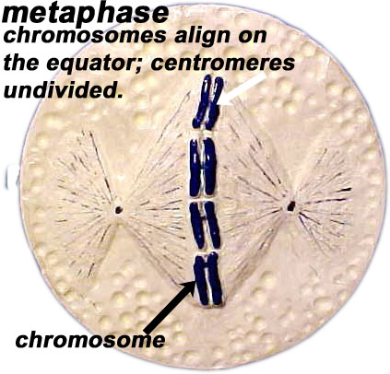
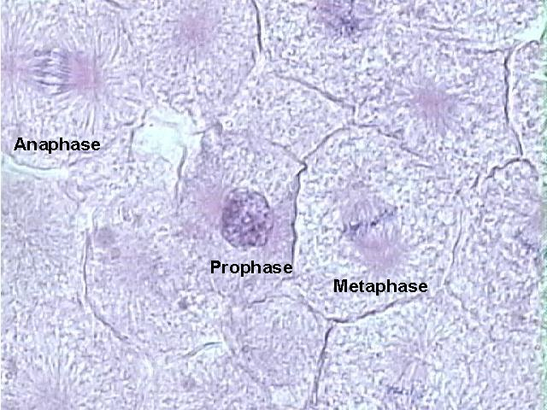
Metaphase: “Meta” means middle!
Chromosomes line up in the middle of the cell and a spindle fiber connects to them at the centromere.

Slide 13
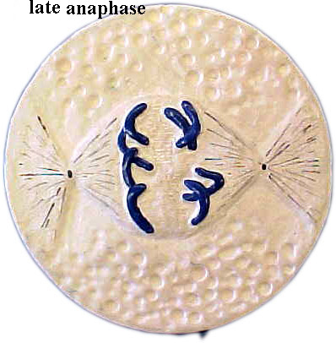
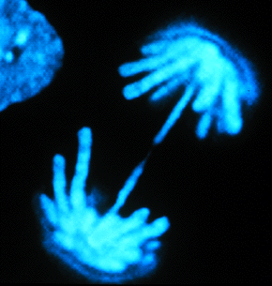
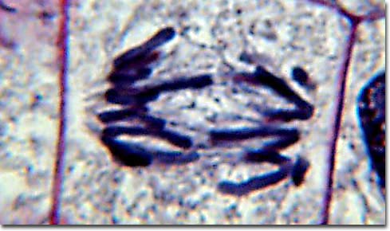
Anaphase:
Chromatids separate (via spindle fiber microtubules) and move to poles (ends), so each side gets an identical copy.

Slide 14
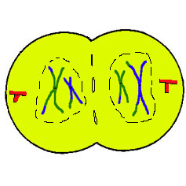
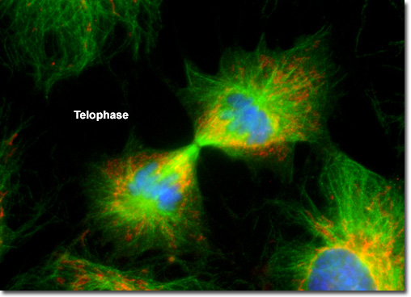
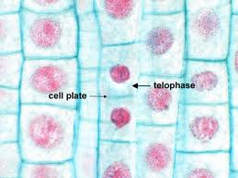
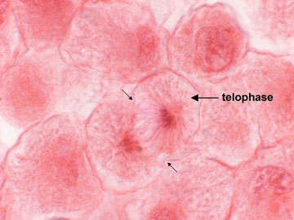
Telophase:
The chromosomes gather at opposite ends and 2 new nuclear envelopes form – we have 2 identical cells now.

Slide 15
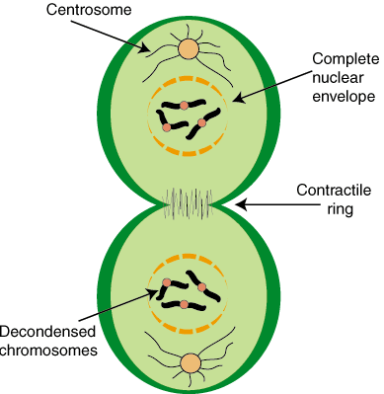
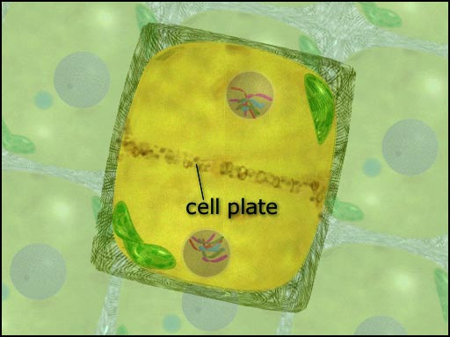
Cytokinesis: (After mitosis)
The rest of the organelles and cytoplasm divides so you have 2 complete cells! Looks different in plants vs. animals. Animals have a cleavage furrow – plants have to create a new cell wall via the cell plate (from Golgi).

Slide 16
Life span of human cells:
Cell Type: | Life Span: | Cell Division:
Esophagus | 2 – 3 days | Yes
Small intestine | 1 – 2 days | Yes
Large intestine | 6 days | Yes
Red blood cells | Less than 120 days | Cannot divide
White blood cells | 10 hours + | Many don’t divide
Smooth muscle | Long lived | yes
Heart muscle | Long lived | Cannot divide
Skeletal muscle | Long lived | Cannot divide
Neuron (nerve cell) | Long lived | Most don’t divide

Slide 17
Does mitosis occur in abrupt jumps between phases, or is it a fluid process from start to finish?
Why is it necessary for a cell to replicate its DNA just before entering mitosis?
Draw a typical chromosome as seen during prophase or metaphase. Describe and label the parts of the chromosome
Interphase is sometimes referred to as “the resting phase” of the cell. Why is this description inaccurate?
How does mitosis relate to regeneration in organisms such as sea stars?
How does mitosis provide for genetic consistency in an organism, and why is this important?

Slide 18
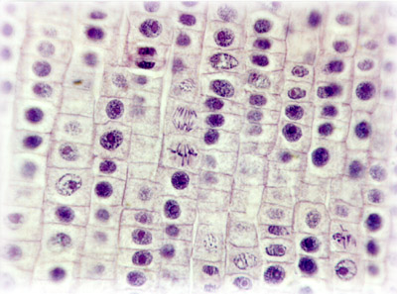
What do you see?

