Slide 1
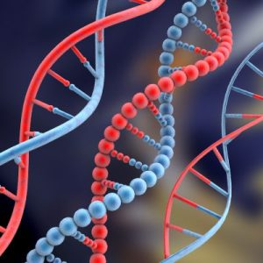
Ch. 13 Transcription/Translation
How your DNA makes you!!

Slide 2
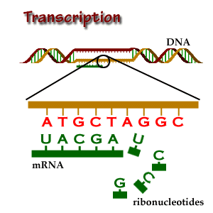
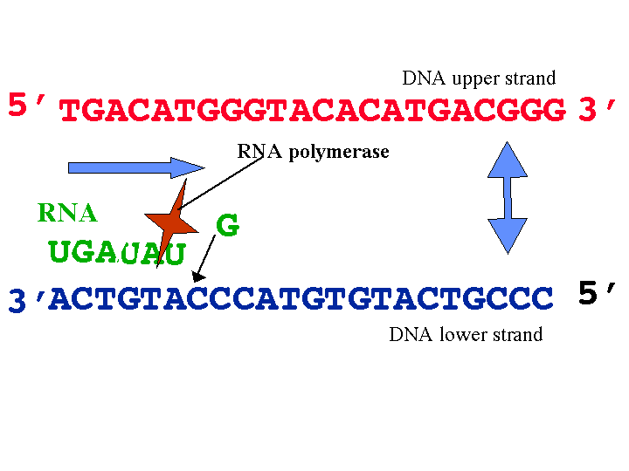
#1.Transcription (DNA to RNA)in your nucleus!
The DNA must stay in your nucleus. It cannot leave because:
It’s too big to fit through the pores.
Enzymes in the cytoplasm would break it down.
SO….It must transcribed to RNA instead (the other nucleic acid). The mRNA leaves the nucleus and carries the message to the ribosome!

Slide 3
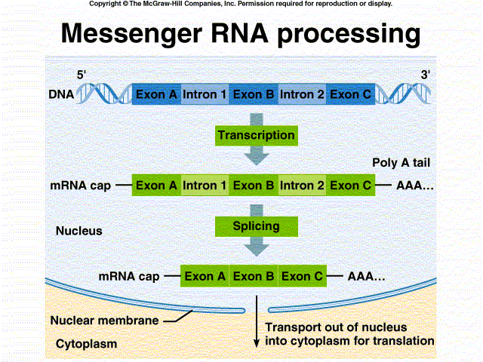
Before the mRNA leaves the nucleus:

Slide 4
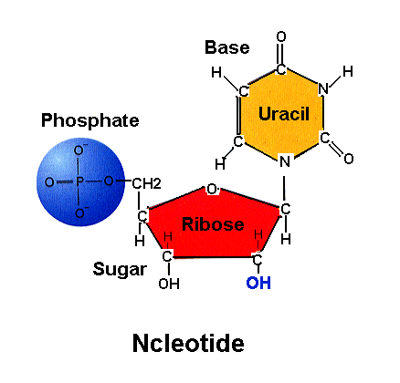
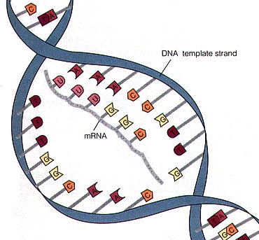
RNA (the other nucleic acid)
Different from DNA in 3 ways:
1. The sugar is ribose (not deoxyribose)
2. The base T thymine doesn’t exist. Instead it is U for uracil.
A pairs with U now!!
3. RNA is single stranded –
DNA is double

Slide 5
Functions of RNA
The three main types of RNA are; 1. Messenger RNA (mRNA) – carries message from DNA to the ribosome in your cytoplasm.
2. Ribosomal RNA (rRNA) makes the ribosome.
3. Transfer RNA (tRNA) brings the correct amino acid (there are 20) to the ribosome, it’s shaped like a clover leaf.

Slide 6
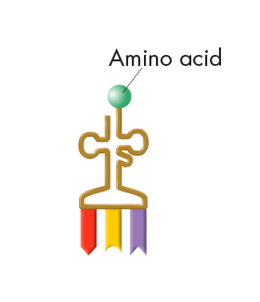
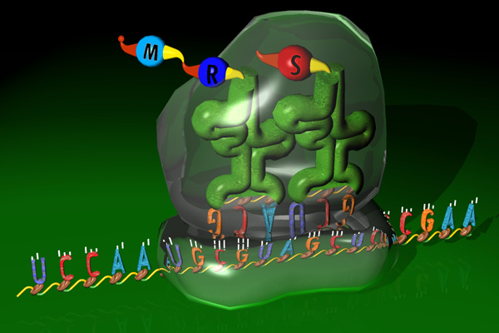
Transfer RNA
When a protein is built, a transfer RNA (tRNA) molecule transfers each amino acid from the cytoplasm to the ribosome to make protein.

Slide 7
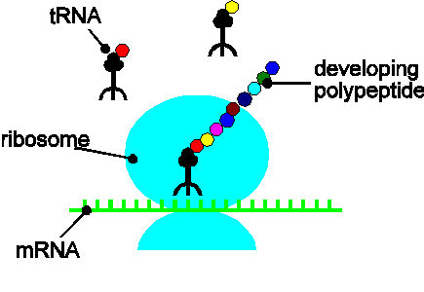
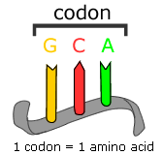
#2. Translation – turning mRNA into protein!
The mRNA goes to the ribosome where it’s 2 parts fit together. The message is fed through and is read 3 “letters” at a time: a codon.
The tRNA in the cytoplasm brings the “anti-codon” opposite 3 letters, which code for the right amino acid.

Slide 8
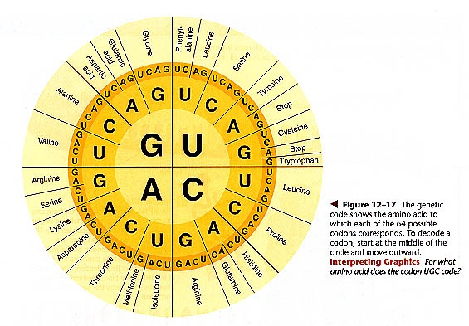
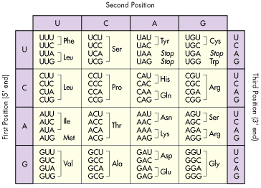
Look up the codons in the book! Page 367:
What is the start codon? How many a.a.’s are there?
How many stop codons? Does each code make a unique amino acid?

Slide 9
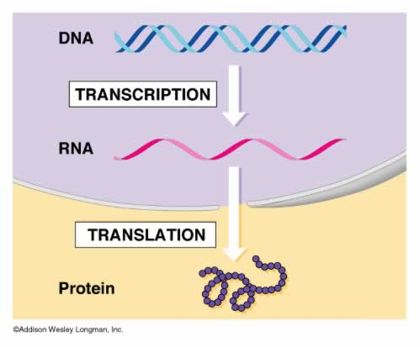
Put it all together:
Result: new proteins wherever you need them!
http://www.youtube.com/watch?v=41_Ne5mS2ls&feature=related

