Slide 1
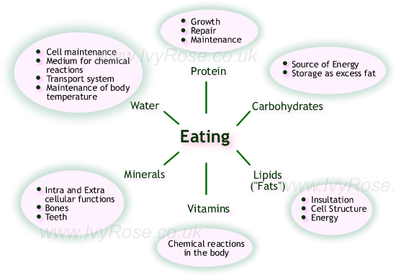
2-3 Macromolecules
The molecules that make “us” up!!
Pennington

Slide 2
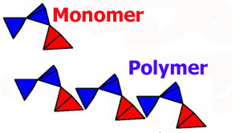
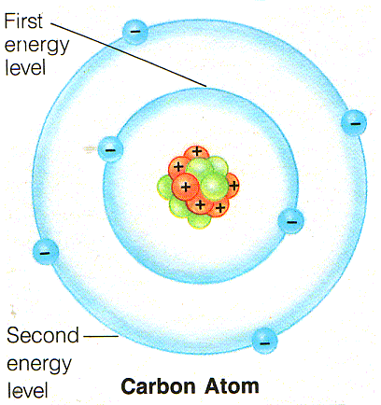
Basic ideas
Monomers – small atoms that bond to form large molecules.
Polymer – contains many monomers
Carbon – special element for 2 reasons:
4 valence electrons – so it bonds with 4 other atoms
Carbon can bond to other carbons – single, double (C=C) triple bonds. Organic means having Carbon, organic chemistry is the study of organic compounds

Slide 3
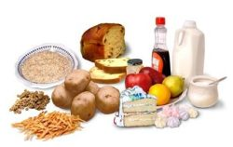
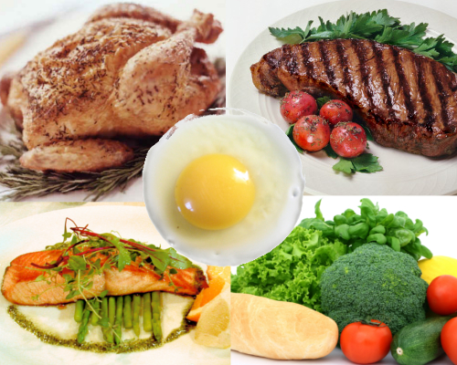
Macromolecules : 4 kinds
1. Carbohydrates – sugar, bread, pasta
2. Lipids – butter, oils, waxes
3. Proteins – peanut butter, meats
4. Nucleic Acids - all

Slide 4
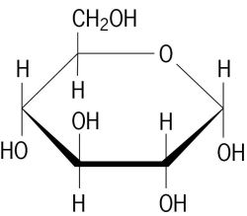
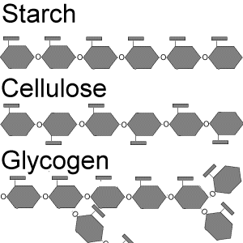
Carbs (made of C, H, O)
Our main energy source
Monomers are simple sugars (ring shaped -
glucose) called monosaccharides
There are 3 you need to know:
a) Glucose b) galactose c) fructose
Polymers are big sugars (polysaccharides)
like starch and glycogen = many rings.
Starch – storage for plants
Glycogen – storage for humans (liver)

Slide 5
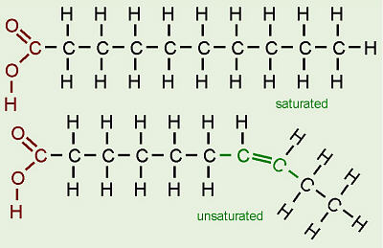
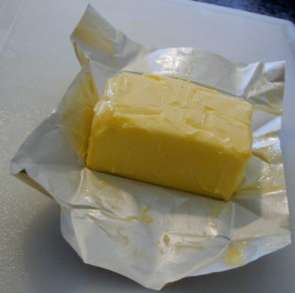
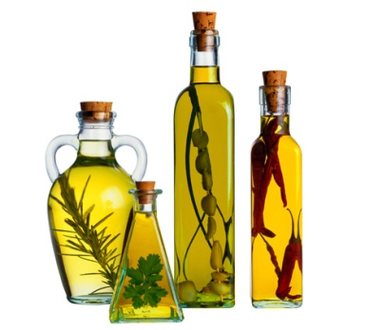
Lipids (aka fats)
Useful for stored energy, make cell membranes. No polymers, but made of a glycerol and 3 fatty acids.
2 kinds-
#1)Saturated, all Carbons have H’s attached
From animals (lard), solid at room temp
#2) Unsaturated, double bonds between C
From plants (olive oil), liquid at room temp, healthier!

Slide 6
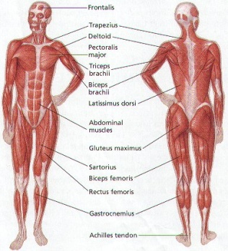
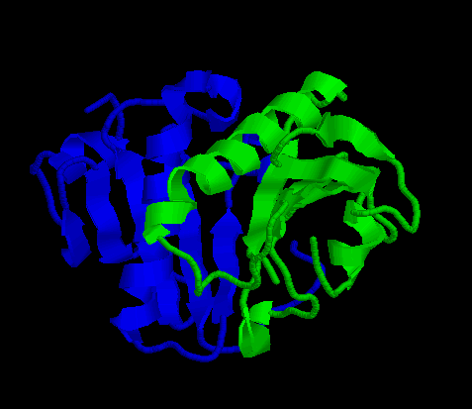
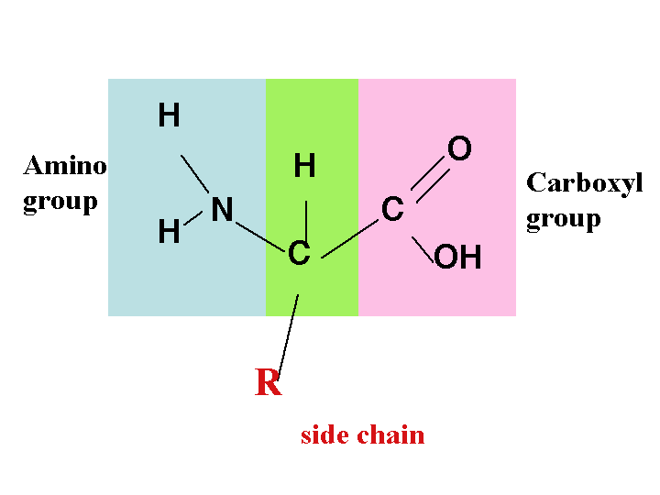
Proteins:
Make the muscle and structure of your body
Monomers are amino acids (20)
One end always has – NH2, the other – COOH
All enzymes and immune system components are proteins!
Proteins fold into specific 3D shapes to perform their function. pH, temperature, salinity can affect this folding and break them down.

Slide 7
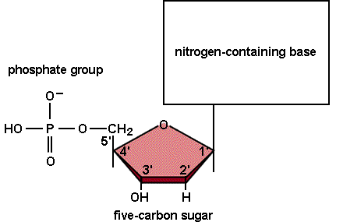
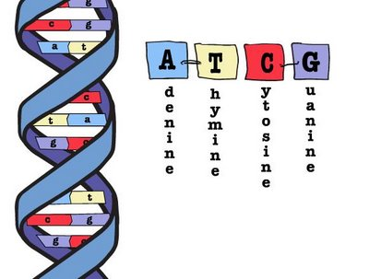
Nucleic Acids:2 kinds= RNA and DNA
Monomers are nucleotides which have 3 parts:
1) 5 carbon sugar
2) phosphate group
3) nitrogenous base – 4 of them represented by A,T, C and G
They store and transmit genetic information.

