Slide 1
Ch. 15 Genetic Engineering
Pre – AP

Slide 2
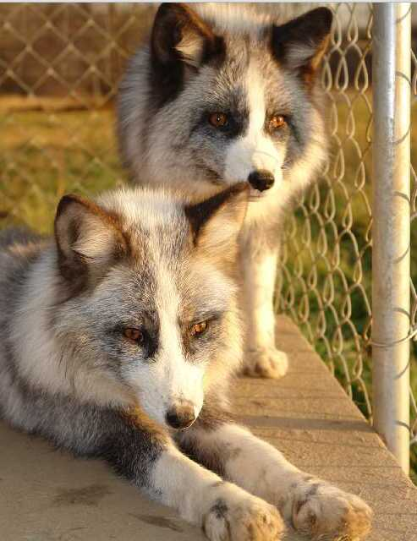
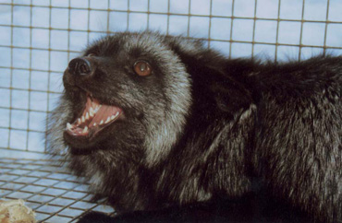
Selective Breeding -
Allowing only those animals with wanted characteristics to produce the next generation.
Ex: Siberian foxes who were friendliest were continually bred.

Slide 3
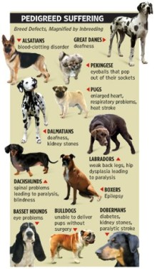
Inbreeding
Continued breeding of individuals with similar characteristics to make sure those traits come through. It’s risky as it also increases rare genetic disorders.

Slide 4
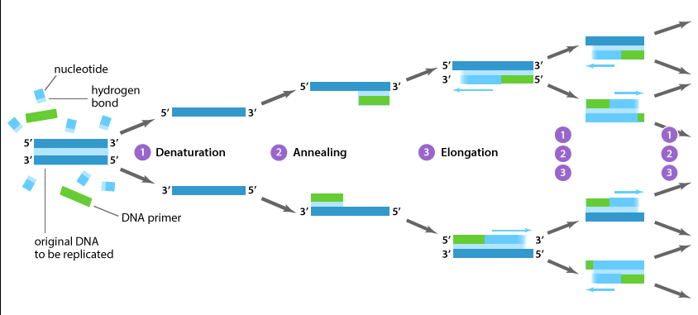
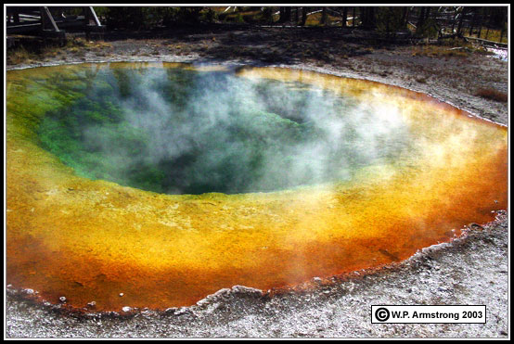
Polymerase Chain Reaction -
Known as PCR. It’s a way to make millions of copies of 1 piece of DNA. Kary Mullis found Taq polymerase – an enzyme that doesn’t denature at high heat needed to separate the 2 strands.

Slide 5
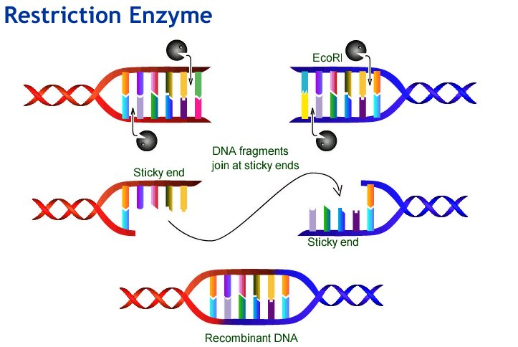
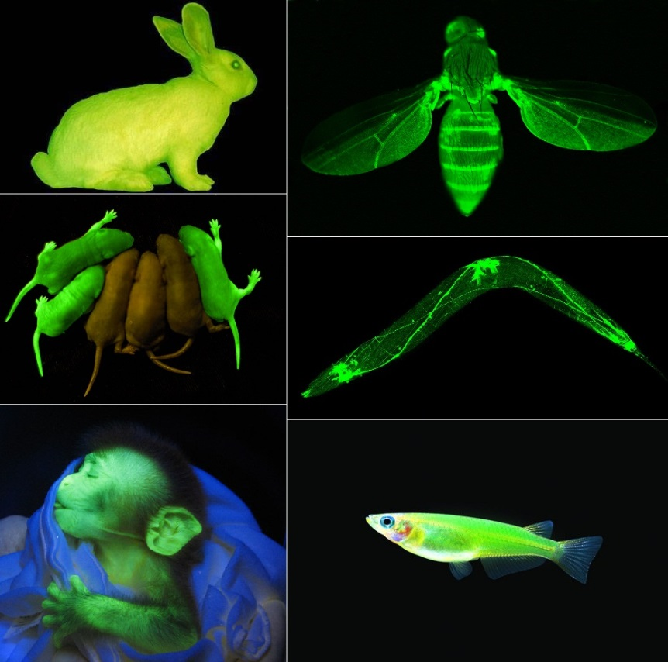
Recombinant DNA -
Putting a gene from one organism into the DNA of another. It will bind as long as the base pairs are complimentary. GFP bacteria:

Slide 6
Plasmids -
Small circular pieces of bacterial DNA that house a few genes. They are used to insert genes we want into bacteria. Ex: human growth hormone, insulin.

Slide 7
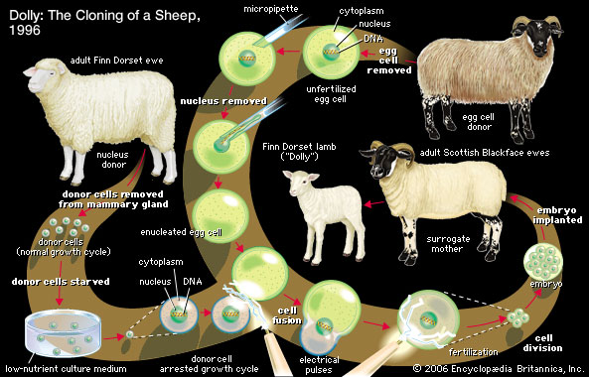
Cloning -
A clone is a member of a population of genetically identical cells produced from 1 single cell. The first mammal was Dolly in Scotland.

Slide 8
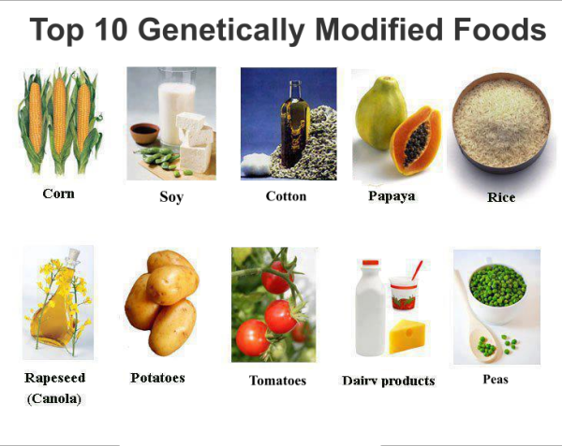
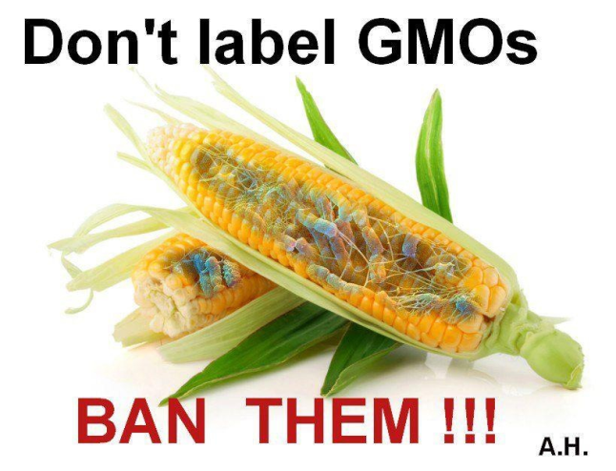
Genetically Modified Organisms -
GMO’s o- Any organism that has foreign genes added into it’s DNA. Can be plants, animals, bacteria. Why?? Could lead to better, less expensive and more nutritious food as well as less-harmful manufacturing process. Better for the environment?

Slide 9
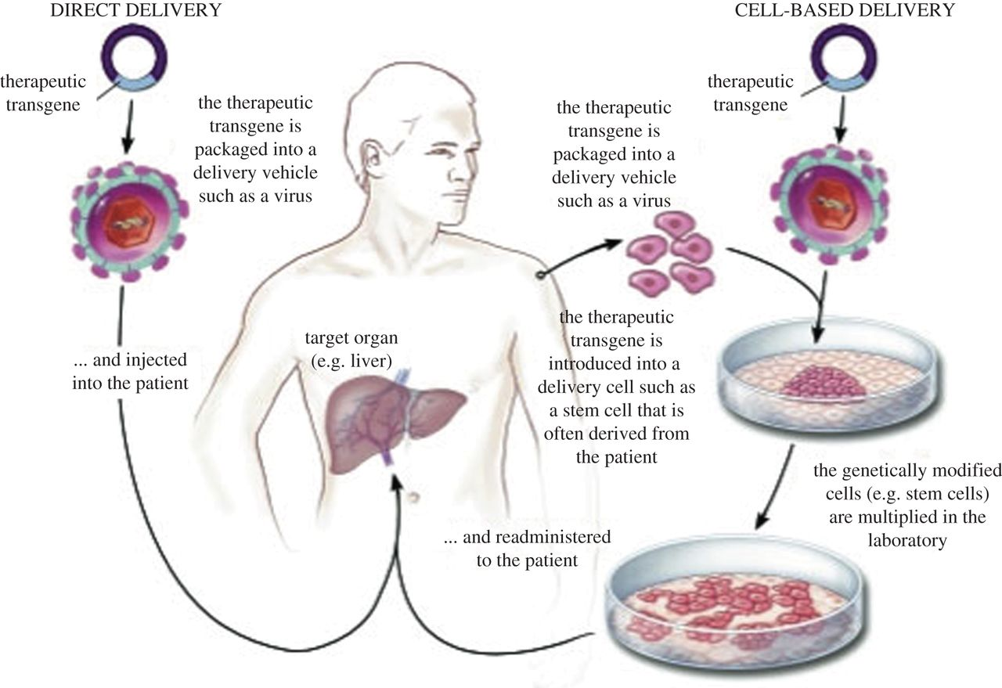
Gene Therapy -
The process of changing a gene o treat a medical disease or disorder. Have to use a virus to deliver good gene into the cell.

