Slide 1
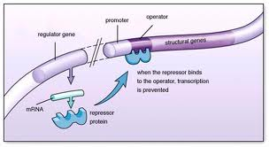
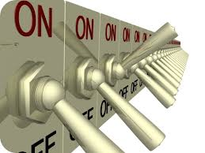
Prokaryotic (Bacterial) Gene Regulation
controlled by DNA-binding proteins
regulate genes by controlling transcription
some proteins switch genes on – make protein
some proteins switch genes off – no proteins

Slide 2
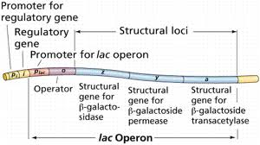
Operons – Prokaryotes ONLY
a group of genes that are regulated together
genes in an operon have related functions

Slide 3
Lac Operon- A specific example
contains three genes
contains two regulatory regions
Promoter – to start binding
Operator – site that can be opened or closed

Slide 4
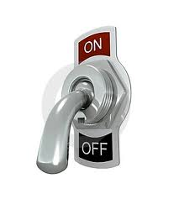
If Lactose Is Not Present…
lac repressor binds to the operator
switches the lac operon off
blocks transcription
Why waste energy to make protein if there is no sugar to break down??

Slide 5
If Lactose is present…
lactose binds to the lac repressor
repressor falls off the operator RNA polymerase can now fit!
lac operon switches on
transcription begins

Slide 6
Eukaryotic Gene Regulation
genes are controlled individually
involves more complex regulatory sequences than prokaryotes

Slide 7
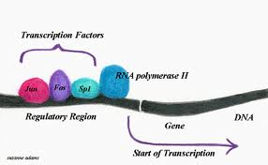
Transcription Factors – Control gene expression
DNA binding proteins
control the expression of genes
some enhance transcription
some attract RNA polymerase
some block access to genes

Slide 8
Watch this in animation!
http://www.youtube.com/watch?v=oBwtxdI1zvk

