Slide 1
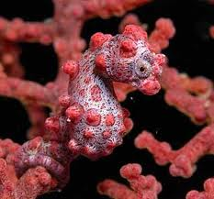
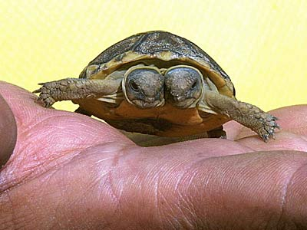
13-3 Mutations Can be good, bad or nothing!!

Slide 2
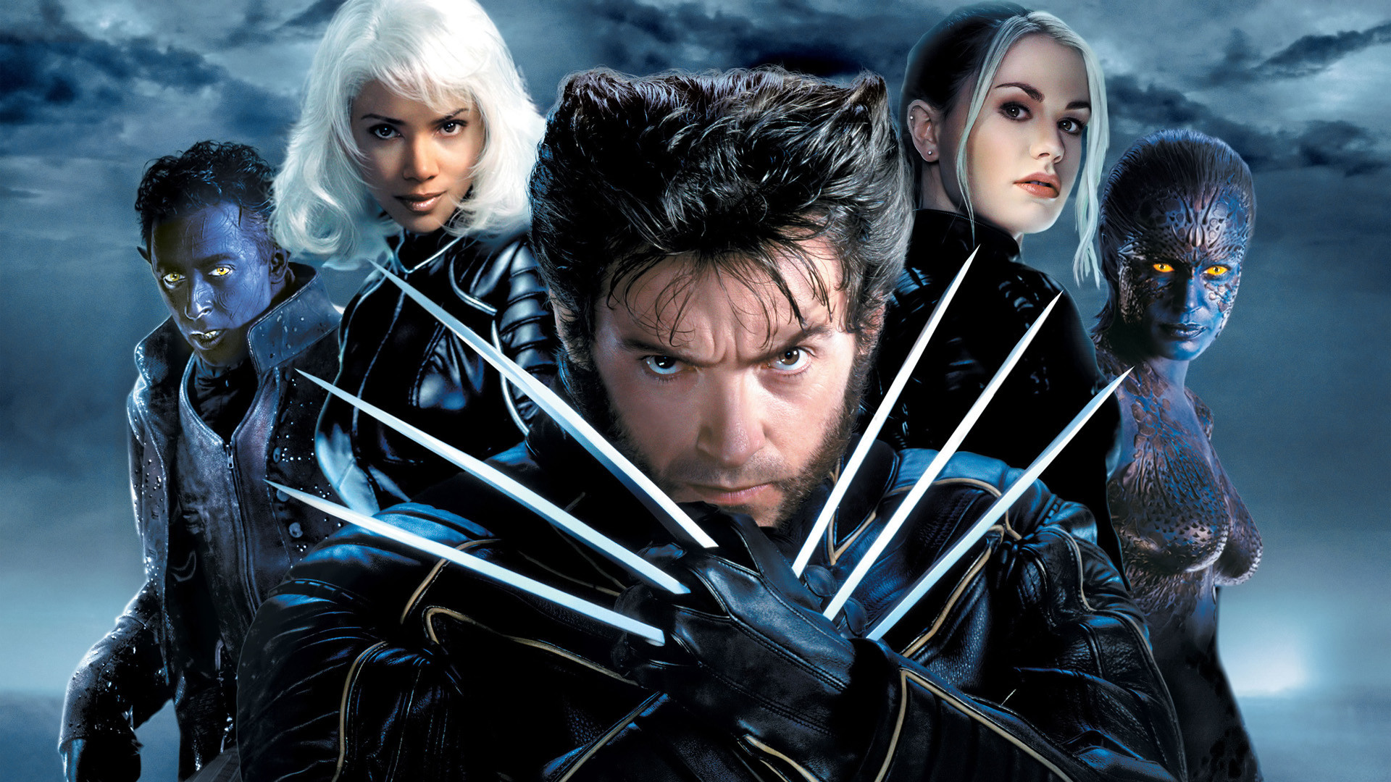
What is a mutation?

Slide 3
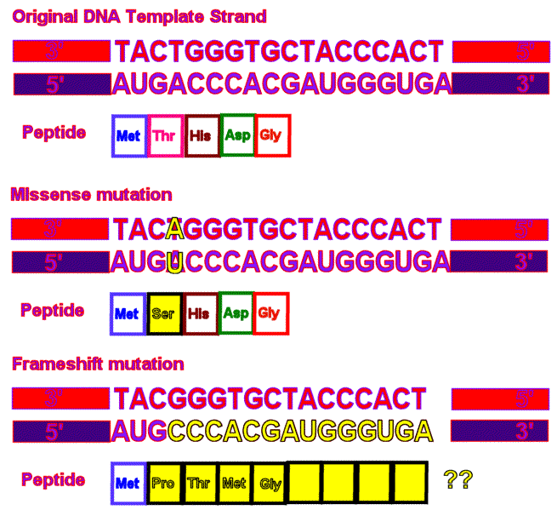
What is a mutation?
The word is Latin for “to change”.
There are 2 types:
1) Single gene changes
2) Entire chromosome
changes

Slide 4
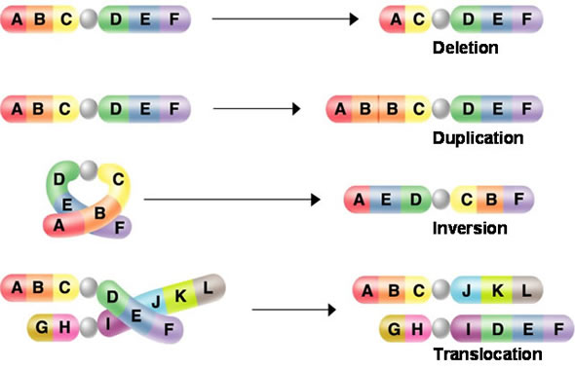
Whole chromosome mutations:
4 types: These cause disorders which we will study soon!

Slide 5
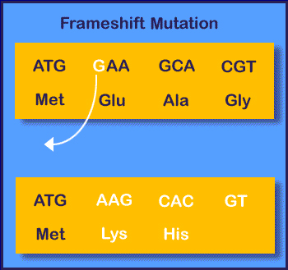
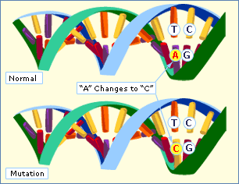
Point Mutations – changes in 1 or a few nucleotides.
1. Substitutions – change in one base
2. Insertions/Deletions- One base in inserted in or deleted. Can cause the whole mRNA frame to shift so are called frameshift mutations.

Slide 6
Types of Mutations
1. Silent – the mutation does not result in an amino acid change.
2. Missense – One amino acid in the chain is changed into a different amino acid.
3. Nonsense – a mutation that causes a stop codon to be coded for instead of the normal amino acid. Supposedly most mutations are harmless!

Slide 7
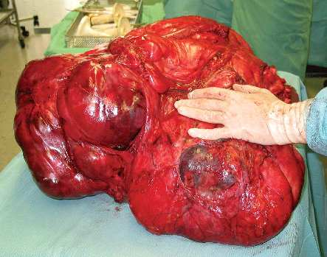
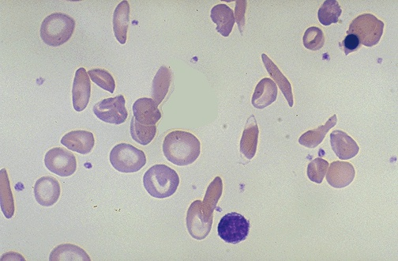
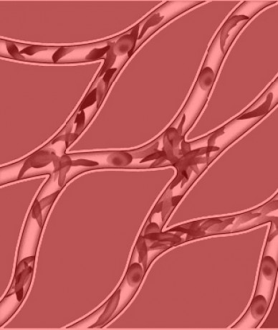
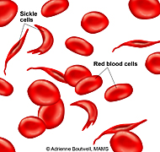
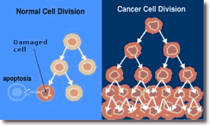
HarmfulMutations http://www.hhmi.org/biointeractive/dna/DNAi_sicklecell.html
Some mutations alter cells and they become cancerous. Sickle cell is caused by a mutation in hemoglobin formation

Slide 8
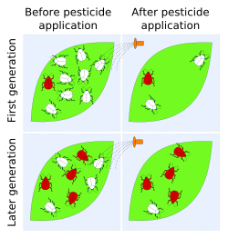
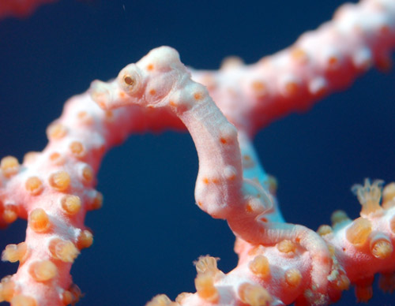
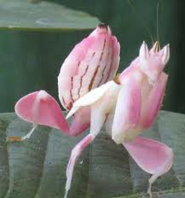
Beneficial Mutations – new proteins makes a change that helps organism survive - evolution

Slide 9
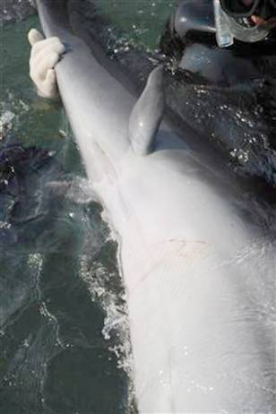
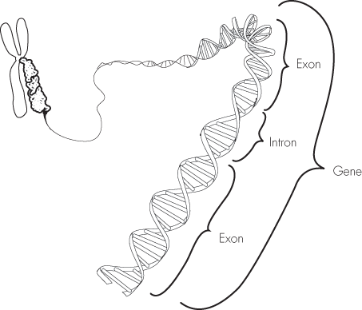
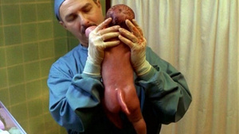
Does all DNA make protein?? No
Non coding DNA (used to be called “junk”) doesn’t make protein. Can be leftover DNA, or genes that are turned off. Ex: human tail bones, dolphin with legs…

Slide 10
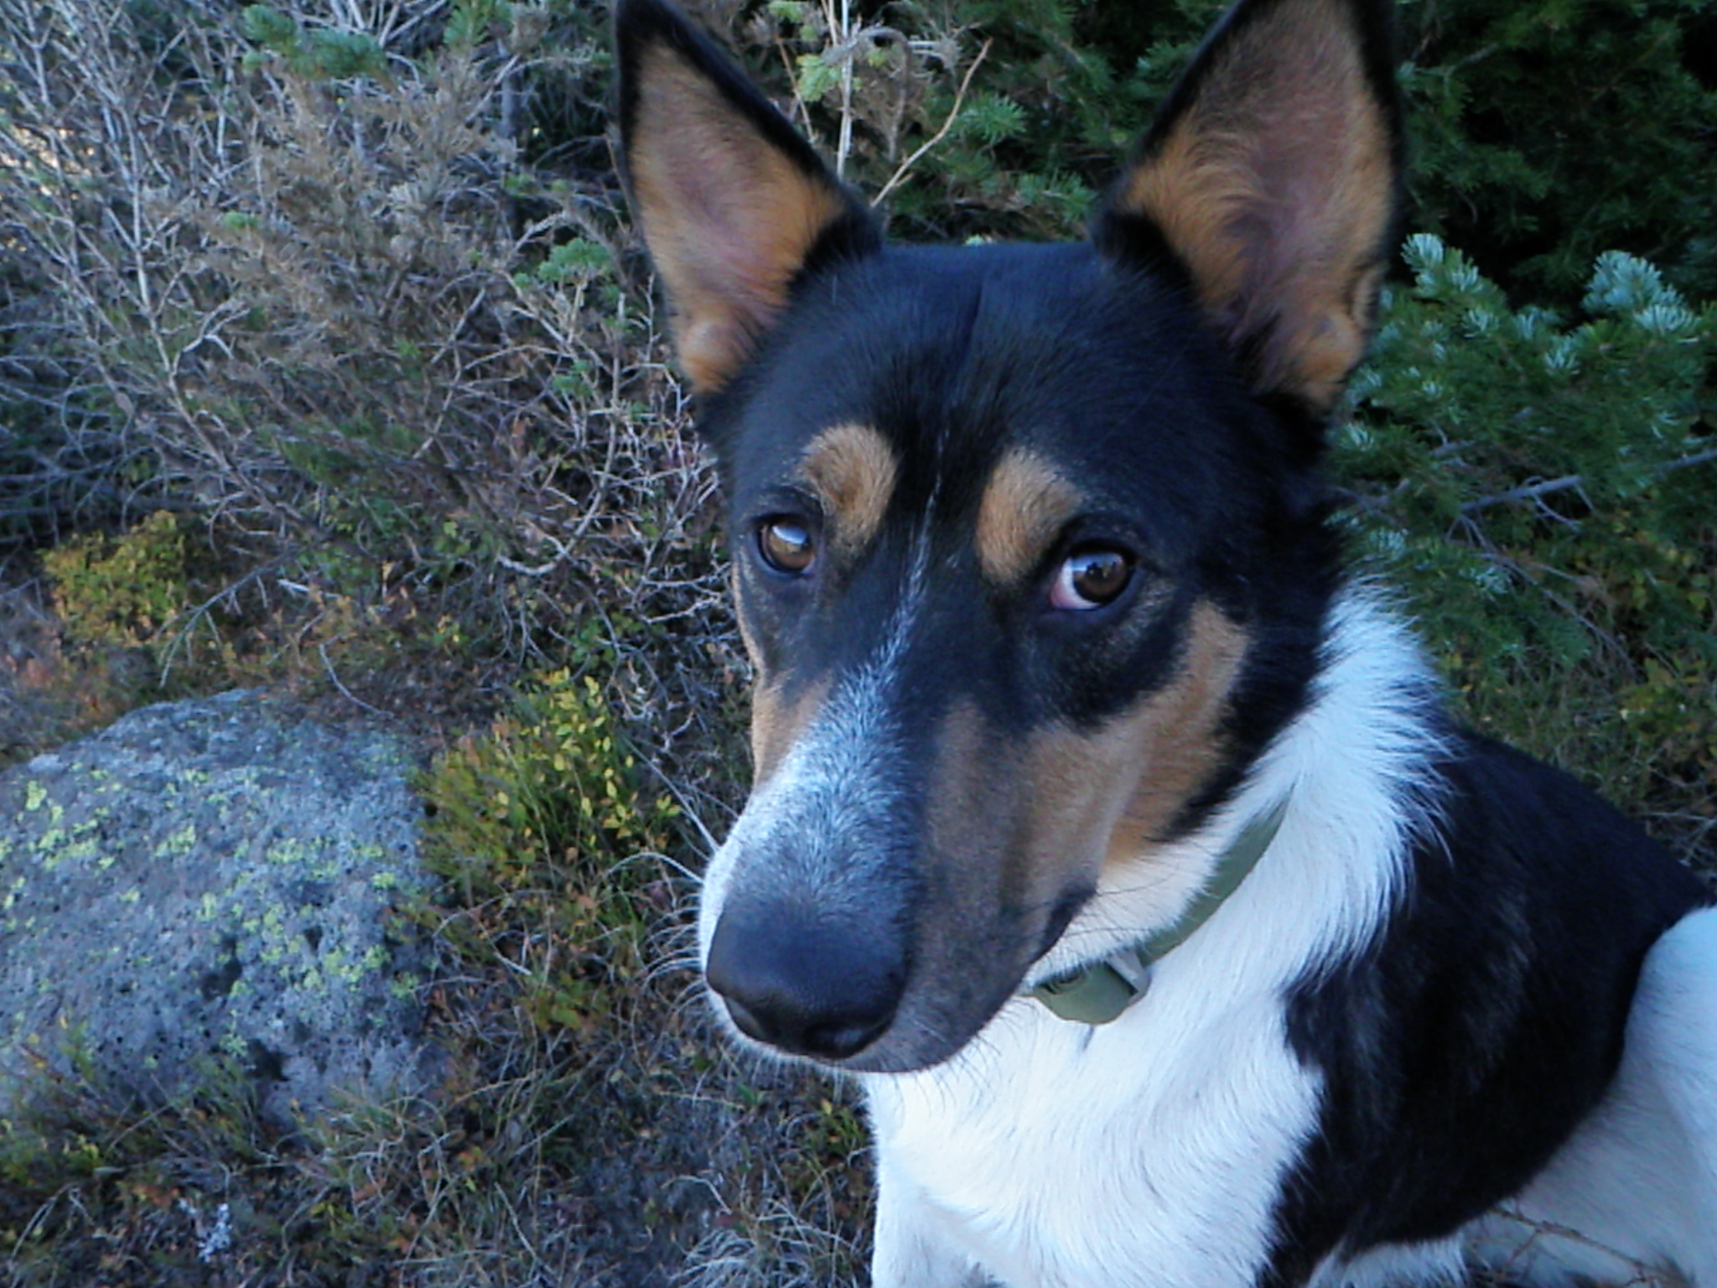
Oatmeal Mutations
My dog’s name is Oatmeal, he will run you down and lick your face.
My dog’s name is Oatmeel, he will run you down and lick your face.
My dog’s name is Oatmeal, he will run you down and kick your face.
My dog’s name is Oatmeal, he will gun you down and kick your face.
My dog’s name is Oatmeal, he will run you down zan dkic kyou rface.
My dog’s name is Oatmel,h ew illr uny oud owna ndl icky ourf ace.

